Slide 1
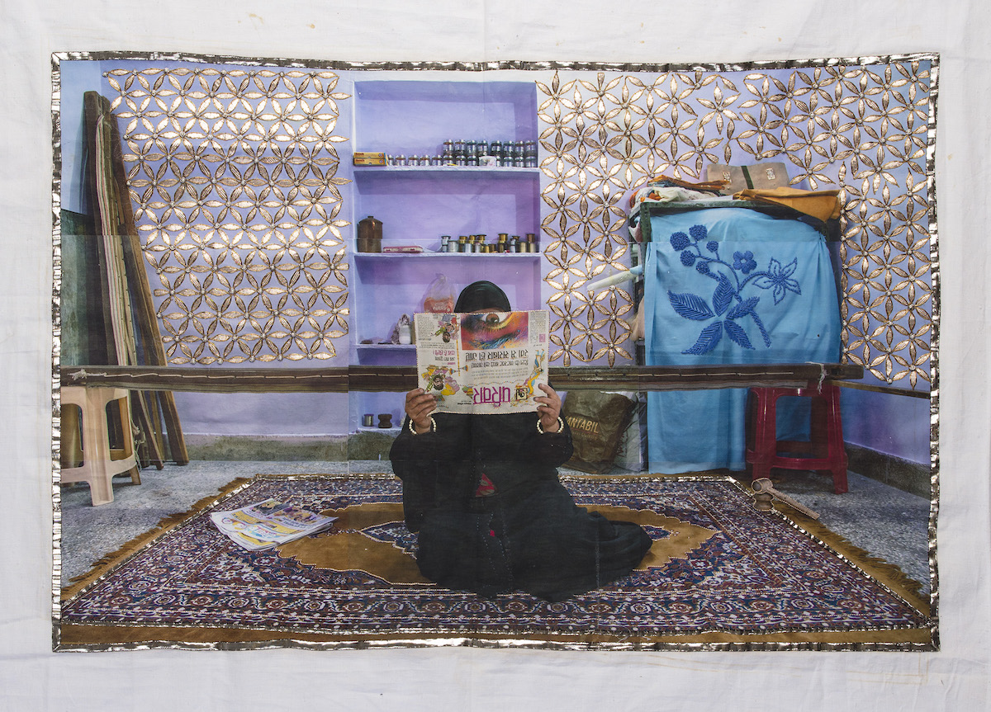
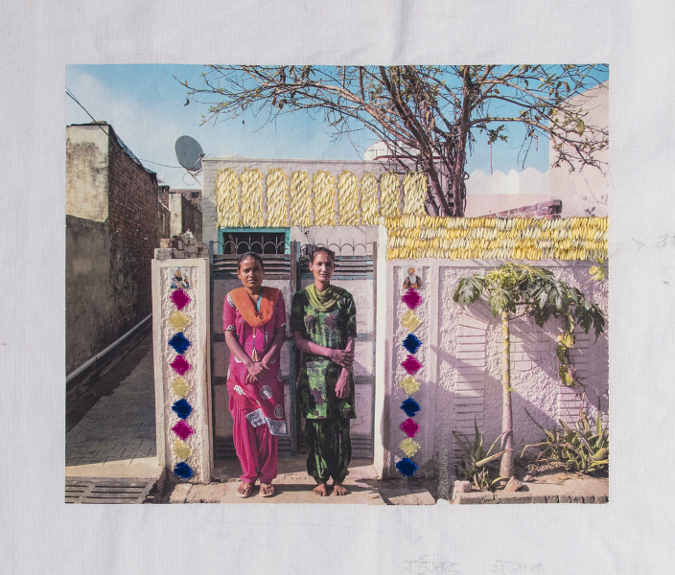
Visual Story Empowerment
Lesson Plan for Contemporary Artist Spandita Malik
“I’m writing my story so that others
might see fragments of themselves.”
- Lena Waithe

Slide 2
Hello! Our Essential Questions:
1. How does listening to and looking at contemporary artists deepen our understanding and capacity for art and design to provide insight into issues facing our society?
2. In what way can we use art to deepen our understanding of other peoples’ circumstances, situations and lives? How can we use art to create room for others to express themselves?

Slide 3
Learning Objectives
1. We will explore how contemporary art can shed light on social issues while providing inspiration about the role artists and designers play in shaping society’s views on issues
2. Learn about the power of personal stories in making art and design
3. Create a work of art using multiple mediums and research
4. Create a visual art platform that incorporates the viewpoints of others on complex social issues
5. Discover how allowing for productive and respectful conversations about sensitive topics strengthen the work

Slide 4
Spandita Malik
“When these women embroider their own portraits, they not only take control over the representation of their own image but they also embed into their images their own silent stories. When I collaborate with these women we create a connection through our art. But when I listen to them through our inherited language of embroidery that’s when I understand the true meaning of Nari.”

Slide 5
Video: Spandita Malik Cabin Fever Artist Talk
Click here to watch video

Slide 6
What is story empowerment?
Story empowerment is the process of how story telling itself gives power back to the teller. The teller is able to reclaim their narrative. In addition, by telling one’s story, it gives power to others who may have similar experiences and/or circumstances.
In participating in this visual dynamic of giving out stories and then receiving others’ stories in return, we have the opportunity to “speak” what was thought of as unspeakable or silenced or difficult to approach.
The process of reclaiming, the process of giving voice to everything that was silenced is what’s able to give that sense of empowerment back to someone.

Slide 7
Identify Story Empowerment
Spend some time on Spandita Malik’s website: https://spandita-malik.com
Read this article on Why Storytelling Matters
Artists/Designers as visual storytellers – check out these websites for more examples of visual storytelling:
Swoon
Jenny Holzer
Casey Ruble

Slide 8
Research!
Do some brainstorming on a person or group of people who’s stories you’d like to hear and you feel people need to hear.
Do some research on potential people or groups you could focus your project on. *TIP* keep it close to your heart, a person or a group you feel passionate about. Find multiple people or groups you could work with as possibilities and keep a working document of all of the above.
Pull out some quotes from personal stories and always write down credits and sources for the quotes.

Slide 9
Creating the Visuals!
Based on the person or groups you are looking at doing your project on, begin brainstorming on how their stories might translate into visuals. Painting, drawing, photography, collage, found objects, fabric etc.
Think about what the visual is symbolizing (the way embroidery in Spandita Malik’s work symbolizes a technique from India and one that was taught through generations).
Test out different mediums and narratives you have found in your research.

Slide 10
Make a connection!
Decide on a person or group you’d like to reach out to. Create a piece of artwork with the materials you’ve settled on and some text or title or content driven by your research. If you do not feel comfortable, simply reach out to a friend.
Send an email or call and explain your project. Include an image of the artwork you made on your own as an extension of trust. Ask if you can make a piece of artwork for that person or group and that you’d like to include their voice. They can absolutely remain anonymous if they’d like to. Ask if they could email a quote or an image or a symbol that represents their story or something they’d like to say.
Create 2nd piece of artwork based on how they respond and their answer to the above inquiries.
Present the two pieces you have made to the group for discussion.
Ask for the mailing address of the person or group you have connected with and mail one or both pieces to them.

